Slide 1
DevOps in the Telco Enterprise

Slide 2
CenturyLink
Telecommunications company from the merger of USWest, Embarq, and CenturyTel
32 States
+47,000 Employees

Slide 3
Starting State
Several million lines of Java
Existing build, install, deployment automation is Java specific
Originally built in 2006
Feature sprawl added as layers not integrated

Slide 4
Before & After
6.5 to 12.5 hours/15 to 45 minutes for build
3 to 12 hours/45 minutes to 2 hours for install & deploy
80 to 120 builds/800 to 1200 builds per month

Slide 5
Needs
Automate build/install/deploy of new languages and technologies
Decrease time required to complete pushes
Integrate new technologies quickly
Maintain existing functionality

Slide 6
Challenges
Some functionality must not break (911)
No differentiation between types of applications
Regulatory exposure
Prototypes may not mature into production applications
Adding new technology to existing automation would sacrifice benefits

Slide 7
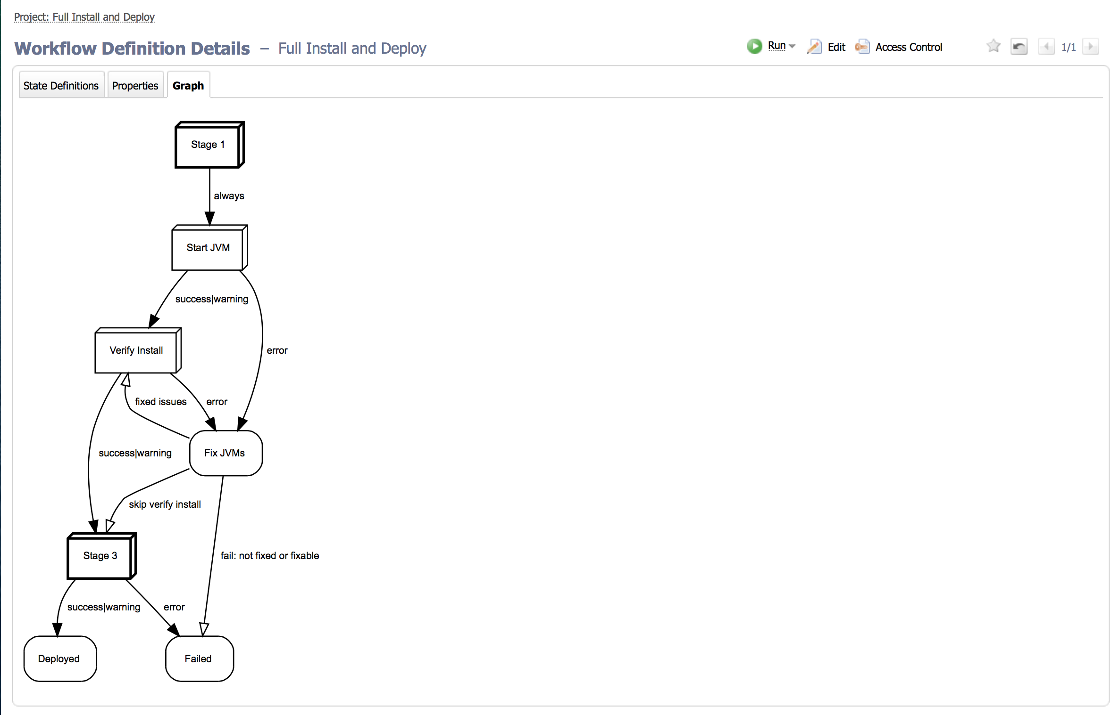
Solution
Workflows are used to create order of events for any code base for any runtime environment on any OS.

Slide 8
Solution
Error capture and handling can be added native to the technology and added to the workflow
Trigger, polling, and timer based action initiation
Built-in capability to notify on status of job
Run in Parallel
Push of all components dropped from >6 hours to 1

Slide 9
Solution
Lab and Production ownership differences can be managed
Integration with Rally & Bugzilla allow for reports on what is in an push or release

Slide 10
Features
Legacy automation still in use for legacy applications
New and emerging tools are automated in less time
Challenge of changes to build, install, deploy process during prototype stage are not as disruptive.

Slide 11
The Future
New platforms to deploy new applications.
Automated testing as part of Workflow and as Project
Continued pressure to lower cycle times
Capture failures and automate failure recovery

